Slide 1


托福听力4
金牌听力名师
大菁儿老师
2021.6.7

Slide 2
第三节课回顾： 对话场景词汇 长对话的综合练习及笔记训练 长演讲的分类、题型及解题技巧

Slide 3
长演讲的分类、题型及解题技巧
分类：对真实大学课堂教授教学和学生课堂讨论的真实还原，涉及题材广泛，
高频常考类型有社会科学、自然科学、生命科学和文化艺术类。
社会科学类主要包括考古学、心理学、社会学、经济学、历史学、教育学、人类学等。
自然科学类主要包括地理学、天文学、环境科学、化学、生态学、物理学等。
生命科学类主要包括生物学、动物学、植物学等
艺术类主要涉及文学、建筑、艺术绘画、摄影、雕塑等题材

Slide 4
1. 主旨题
What is the main idea of this lecture?
文章的开头直接给出；上节课➕本节课；重复；
新旧理论；专有名词；总结词；细节是错误选项

Slide 5
2. 细节题：
What does the word “anthropologist" mean? According to the passage, What is the most significant event in 2.000 B.C.?
Why does the critic dislike the ancient style of sculpture?
把握信号词，如因果的accordingly，thus，列举、相似或对比、转折、强调、总结、定义、建议、数字。

Slide 6
3. 态度题：
What is the professor’s attitude toward......？
通过语气、语调、重读来推测
演讲中比较学术，通过形容词和副词的褒贬色彩来确定说话者的意图。
正确选项不是直接表述。

Slide 7
4. 推断题：
What does the woman imply about the new medical research?
What can we infer from the professor’s comment on the New England system?
推断须基于原文，着重听语气，其实考察细节，选择主旨相关内容

Slide 8
5. 重听题：
Listen again to part of the lecture, then answer the question.
What does the professor mean when she says this?
说话人的语气加强时、有人提问、文章结构转折处
结合重复的内容在录音材料中的上下文去推理才能得出答案

Slide 9
组织结构题：
What is the organization of this passage?
How is the lecture organized?
What method does the professor use to develop his idea?
考得很少但让人头疼
文章的组织结构，记录逻辑展开的框架

Slide 10
内容连接题：
what’s the likely outcome of doing procedure X before procedure Y?
记笔记的能力，注意听顺序性的词
没有顺序性词提示，词汇含义、逻辑关系如因果、转折、强调、比较进行梳理。
会结合细节考查。

Slide 11
配对表格题：
In the lecture, the professor discusses characteristics of folktales and fairy tales, indicate the characteristics of each type of the tale...Click in the correct boxes. This question is worth two points.
信息对号入座 混偏反无一定不能选
文章中会出现两个人或物，对它们多方面进行比较与对比。
在听文章时，要对对是否可能会出现表格题进行预判，掌握先机。

Slide 12
十大考点——主旨+定义；
自然科学词汇串讲
考古学、心理学文章精讲精练

Slide 13
考点一
记主旨：lecture里主旨出现在1’20左右。
Today I will be talking about…
I will be discussing…
I am here to talk about…
I wonder if you can…
I ’ve got some questions about…
Now/today/this time/this period…

Slide 14
主旨题练习1
TPO52-L4玛雅文明~1'09
archaeology
ancient civilization
settlements
date back
cultural achievement

Slide 15
练习
TPO52-L4玛雅文明~1'09
笔记
Maya-anc cilvl(mex+ cen us)
3000 Y (6-900 ce)
golden age”classic peri”
after...”post~~~”
evi: flourish “late post~~~”

Slide 16
TPO52-lecture4
1.What is the main purpose of the lecture?
A. To familiarize students with the Mayan civilization in the Classic Period
B. To prepare students for an archaeology project about the Mayan civilization
C. To provide evidence for a point made in a previous class about the Mayan civilization
D. To call into question a common view about the decline of ancient Mayan civilization

Slide 17
主旨题练习2
TPO29-L3克洛维斯人的藏物处
settlement
archaeologists
clovis people
Hemisphere
address question

Slide 18
练习
TPO29-L3克洛维斯人的藏物处0-'41
笔记
clovis 人 2？（when arrive+ 1 西半球？）
culture

Slide 19
TPO29-lecture3
1.What is the main purpose of the lecture?
A. To explain the method used to date Clovis caches
B. To compare two different types of Clovis caches 贮藏处
C. To discuss possible interpretations of Clovis caches
D. To show how caches indicate the route traveled by the Clovis people

Slide 20
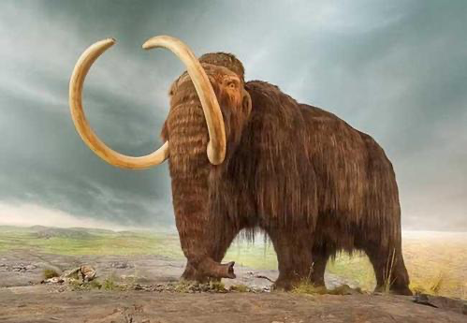
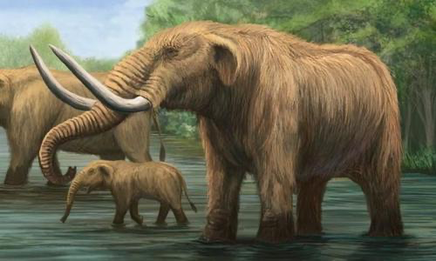
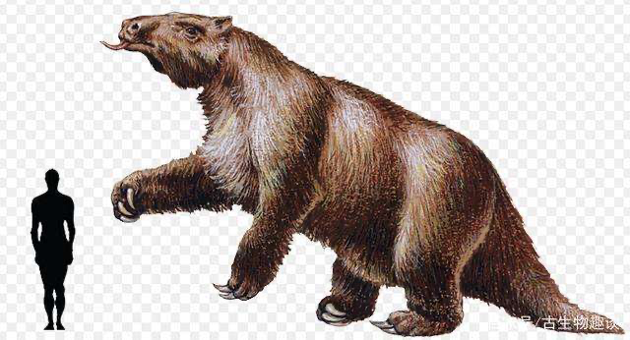
主旨题练习3
TPO24-L3巨型动物~54’
mammoths 猛犸象
mastodons乳齿象
tusks长牙
giant sloths大地懒

Slide 21
练习
TPO24-L3巨型动物
笔记
11-10 BCE m+m big tusk
camels, giant sloths
maga fauna dis
theory1:human clovis plp

Slide 22
TPO29-lecture3
1.What is the lecture mainly about?
A. Theories about how large animals were able to survive the most recent ice age
B. Environmental changes that occur following an ice age
C. Theories about the hunting methods used by early humans in North America
D. Explanations for the disappearance of large animals in North America

Slide 23
考点二 ：记定义
提示: What I mean by … is …
或自己问问题：what is…？
屏幕出现生词，随时出现解释（必考）把解释的名词听出来，
不用写意思，听懂即可
信号词：
what I mean is…
All that means is…
…which is/that is…
…is… In other words,…
… is referred to as…
… is named/known/called…

Slide 24
定义练习1
TPO2-L1 行为主义 45‘-52’
laryngeal
larynx喉
voice box

Slide 25
One kind of habit that he studied are laryngeal habits.Watson thought laryngeal habits...you know, from larynx, in other words, related to the voice box...
2.Why does the professor say this?
A. To give an example of a laryngeal habit
B. To explain the meaning of a term
C. To explain why he is discussing laryngeal habits
D. To remind students of a point he had discussed previously.

Slide 26
心理学场景词汇
aggressive behavior [əˈgresiv] - 侵犯行为；攻击行为
amnesia [æm'niʒə] n.失忆
analogue ['ænəlɒɡ] adj.相似物的；n.相似物
anticipate [æn'tɪsə'pet] v.预期
behaviorism [bɪ'hevjɚ,ɪzəm] n.行为主义
blind spot [blaɪnd][spɒt] 盲点
capability [ˌkeɪpəˈbɪləti] n.才能，能力
capacity [kə'pæsɪtɪ] n.容量
cognition [kɒgˈnɪʃn] n.认知，认识
cognitive [ˈkɔgnitiv] adj.认知的，认知能力的
conditioning [kən'dɪʃənɪŋ] n.条件，条件反射
consciousness [ˈkɒnʃəsnəs] n.意识，观念；知觉
subconscious [,sʌb'kɑnʃəs] adj.潜意识的；下意识的

Slide 27
心理学场景词汇
distraction [dɪ'strækʃən] n.注意力分散
disturbing [dɪ'stɝbɪŋ] adj.使人不安的
electrode [ɪ'lektrəʊd] n.电极
empathy ['ɛmpəθi] n.同感共鸣，感同身受
gist [dʒɪst] n.要点
hasten ['hesn] v.加速；使加紧；催促
hesitation [,hɛzə'teʃən] n.犹豫；踌躇
identify [aɪˈdentɪfaɪ] v.识别认出
ideomotor [ɪdɪə'motɚ] adj.观念运动的; 意想[精神]性运动的
imitation [,ɪmɪ'teʃən] n.模仿
intelligence [ɪnˈtelɪdʒəns] n.智力
low priority [ləʊ][praɪ'ɒrɪtɪ] 低优先级
dmental ['mɛntl] adj.精神的，思想的，心理的
mentality [mɛn'tæləti] n.心态; 思想方法 智力, 智能
muscular ['mʌskjəlɚ] adj.肌(肉)的
objective [əb'dʒektɪv] adj.客观的
subjective [səb'dʒɛktɪv] adj.主观的

Slide 28
心理学场景词汇
optic nerve ['ɒptɪk] [nɜːv] 视觉神经
perception [pə'sepʃ(ə)n] n.洞察力
questionnaire [,kwestʃə'nεə] n.问卷
repress [rɪ'prɛs] v.压抑
self-awareness - [ə'wɛrnəs] n.自我意识
self-recognition - [,rɛkəɡ'nɪʃən] n.自我认知
sign language [saɪn] - 聋哑人的手语
social behavior ['soʃl] [bɪ'hevjɚ] 社会行为
sparse [spɑrs] adj.稀疏的；稀少的
stimulus ['stɪmjələs] n.刺激（复数：stimuli）
prop [prɑp] n.道具；支撑物
immediate environment [ɪ'midɪət] - 直接环境
uncertain [ʌnˈsɜ:tn] n.不确定的；不稳定的
visual cortex ['vɪʒjʊəl] ['kɔ:teks] 视觉皮层
infant ['ɪnfənt] n.婴儿
inborn [,ɪn'bɔrn] adj.天生的；先天的
innate [ɪ'net] adj.先天的；固有的；与生俱来的
instinctive [ɪn'stɪŋktɪv] adj.本能的
negative ['neɡətiv] adj.消极的
presumably [prɪˈzuːməbli] adv.据推测，可能

Slide 29
练习：
TPO15-lecture1注意力分散的处理机制
Cognitive Failures Questionnaire
measure distraction
frequency
Lavie
irrelevant information
low priority
monitor
perceive

Slide 30
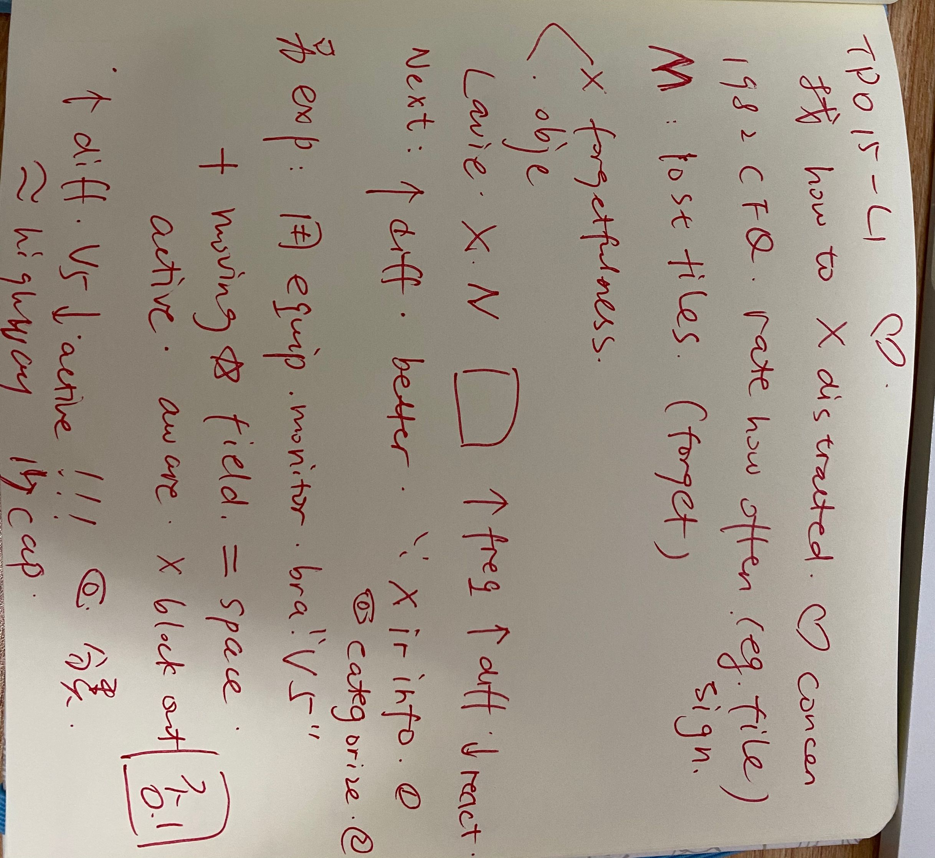
TPO15-conversation1
笔记

Slide 31
TPO15-lecture1
1.What is the lecture mainly about?
A. Methods people use to eliminate distractions
B. The area of the brain responsible for blocking distractions
C. The usefulness of questionnaires in assessing distractibility
D. Research about how the brain deals with distractions

Slide 32
TPO15-lecture1
2.According to the professor,what are two weaknesses of the Cognitive Failures Questionnaire?
[Click on 2 answers.]
A. It relies on subjective reporting.
B. It assesses a limited number of situations.
C. It does not assess visual distractions.
D. It does not account for factors other than distractibility.

Slide 33
TPO15-lecture1
3.What hypotheses about distraction and the brain were Lavie's experiments involving star fields designed to investigate? [Click on 2 answers.]
A. Whether the capacity of the brain to process irrelevant information varies from person to person
B. Whether the brain perceives information that is irrelevant to the
C. Whether the brain deals with distractions by categorizing irrelevant information as low priority
D. Whether the visual cortex is activated during the sensation of movement

Slide 34
TPO15-lecture1
4.What did Lavie's scans of subjects' visual cortexes reveal?
A. Area V5 became less active when tasks became more difficult.
B. The presence of the star field did not affect activity in area V5.
C. Area V5 became more active as more information appeared on the screen.
D. Stimulating area V5 interfered with subjects' ability to perceive motion.

Slide 35
TPO15-lecture1
5.Why does the professor mention a highway?
A. To compare two experiments designed to study distraction
B. To give an example of when area V5 might be activated
C. To describe a limitation in the brain's processing capacity
D. To make a point about the effect of distractions on driving

Slide 36
TPO15-lecture1
6.What is the professor's opinion of Lavie's work?
A. She thinks it resolves most of the major questions about distraction.
B. She feels it is of limited use because of flaws in the study designs.
C. She believes it has changed the direction of research on distraction.
D. She thinks its findings can be applied only to visual distraction.

Slide 37
考古学场景词汇
archaeology [,ɑrkɪ'ɑlədʒi] n.考古学
prehistory [priˈhɪstəri] n.史前时期
Stone Age - 石器时代
Neolithic ['niə'lɪθɪk] adj.新石器时代的
Paleolithic [,pelɪo'lɪθɪk] adj.旧石器时代的
primitive ['prɪmətɪv] adj.原始的, 远古的, 古老的; 初期的, 最早的
antiquity [æn'tɪkwəti] n.古老；古代；古迹；古物
civilization [ˌsɪvələ'zeʃən] n.文明
settlement ['sɛtlmənt] n.定居，安居地
inhabitant [inˈhæbitənt] n.居民
debris [dəˈbris] n.碎片，残骸，废墟
remains [rɪ'menz] n.残余，遗骸；遗迹
ruins ['ruɪns] n.废墟；（建筑物）倒塌
specimen [ˈspɛsəmən] n.样品；范例
indicator ['ɪndɪketɚ] n.指示物
speculation [ˌspɛkjəˈleʃən] n.推断
documentation ['dɑkjəmɛn'teʃən] n.记录
excavation [,ɛkskə'veʃən] n.挖掘；发掘物，出土文物

Slide 38
考古学场景词汇
oversee ['ovɚ'si] v.监督，监视
scratch [skrætʃ] v.擦，刮；n.划痕
crack the code [kræk] - 破译密码
decipher [dɪ'saɪfɚ] v.破解；解译
mold [mold] v.塑造
crane [kren] n.吊车，起重机
mechanic [məˈkænɪk] n.技工，机修工；adj.手工的
hieroglyph ['haɪərəɡlɪf] n.象形文字；秘密符号
pictograph ['pɪktoɡræf] n.象形文字
inscription [ɪnˈskrɪpʃən] n.铭文; 碑文
sacrificial vessel [,sækrɪ'fɪʃl] ['vɛsl] 供具；礼器
camp site - 营地
spear [spɪr] n.矛；枪；（某些植物的）嫩枝
artifact ['ɑrtə,fækt] n.人工制品(尤指原始工具)
cache [kæʃ] n.藏物处；隐藏处
fertile ['fɝtl] adj.富饶的，肥沃的；能生育的
hub [hʌb] n.中心
inundation [,ɪnʌn'deʃən] n.洪水；泛滥

Slide 39
考古学场景词汇
mobile [ˈmobəl] adj.可移动的；行动自如的
near east - 近东
burial site ['bɛrɪəl] - 墓地
cargo ['kɑrɡo] n.货物
dial [ˈdaɪəl] n.刻度盘
ceramic [sə'ræmɪk] adj.陶瓷的；陶器的；n.陶瓷，陶瓷制品
pottery ['pɑtəri] n.陶器；陶器厂；陶艺
shipwreck ['ʃɪprɛk] n.遇难船只，沉船
anchor [ˈæŋkə(r)] n.锚；抛锚停泊；v.抛锚；使固定
corroded [kə'rəudid] adj.被腐蚀的，受侵蚀的
submerge [səb'mɝdʒ] v.淹没；把…浸入；沉浸
subsidence [səb'saɪdns] v.下沉；沉淀；陷没

Slide 40
练习：
TPO50-lecture1
trade and commerce
Bronze Age
archeological excavation
production stage
transparent mineral
vessels
jar
clay
metallic dye
Mesopotamia
precious stones
emeralds and pearls
bead
sophisticated process
perfume
royal family
mutual trade
disk

Slide 41
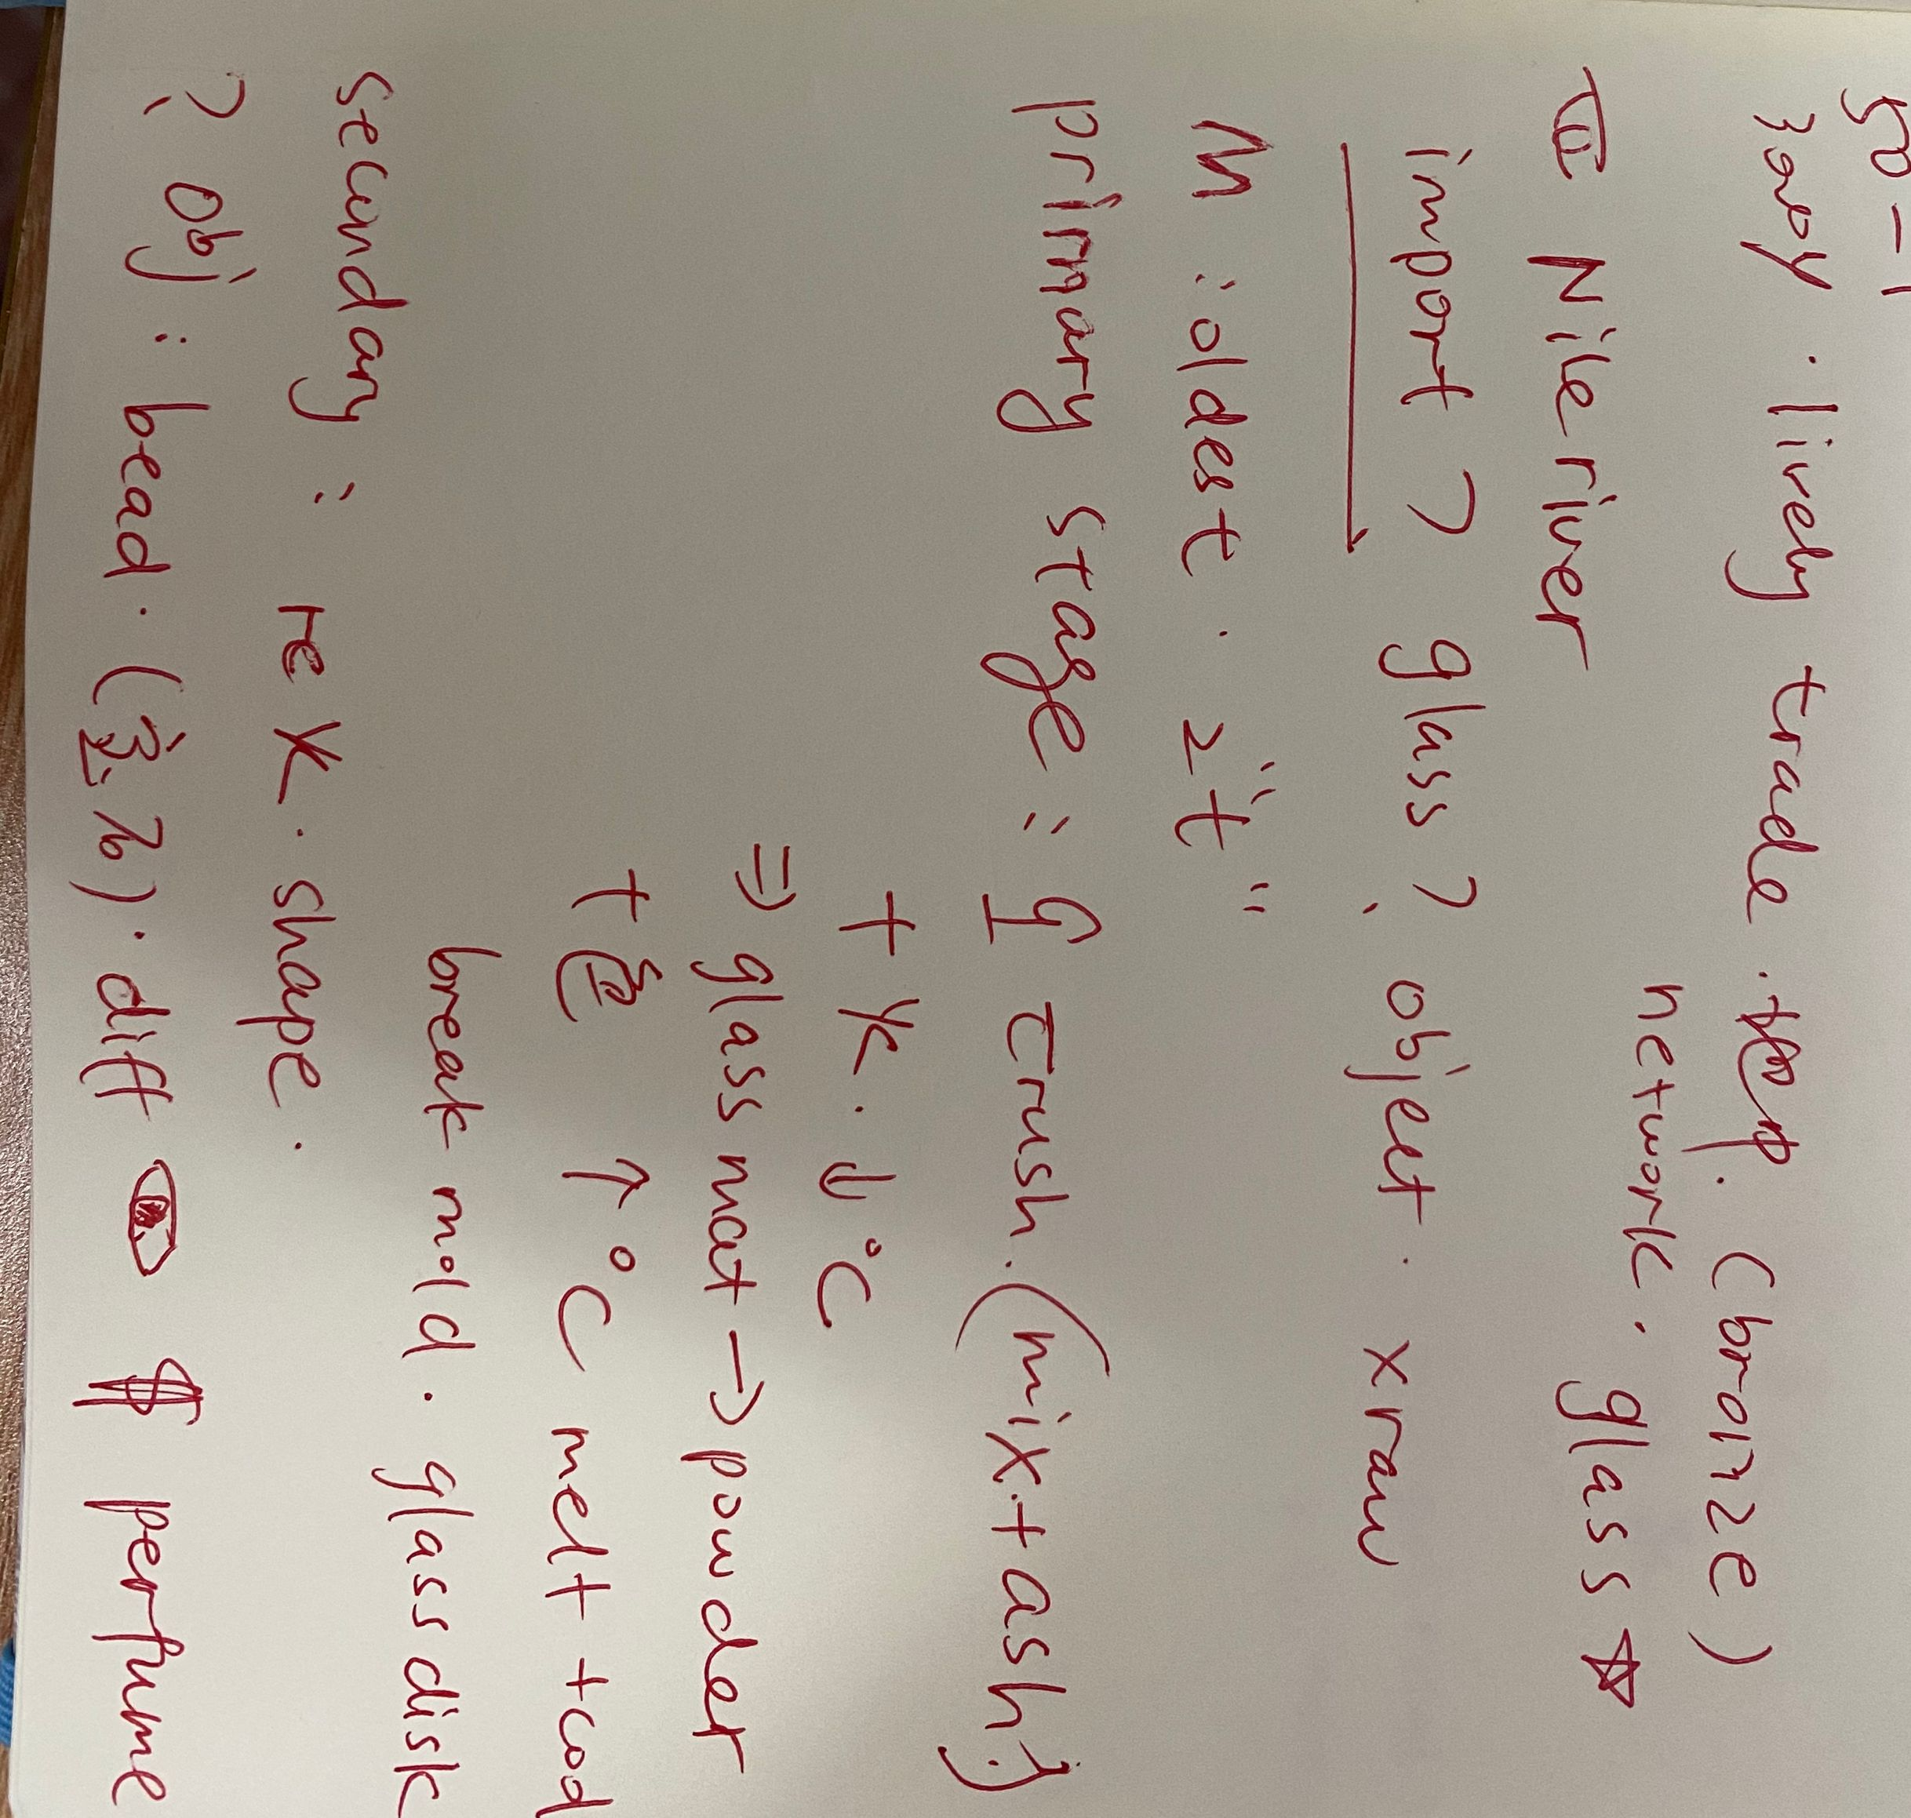
TPO50-lecture1
笔记

Slide 42
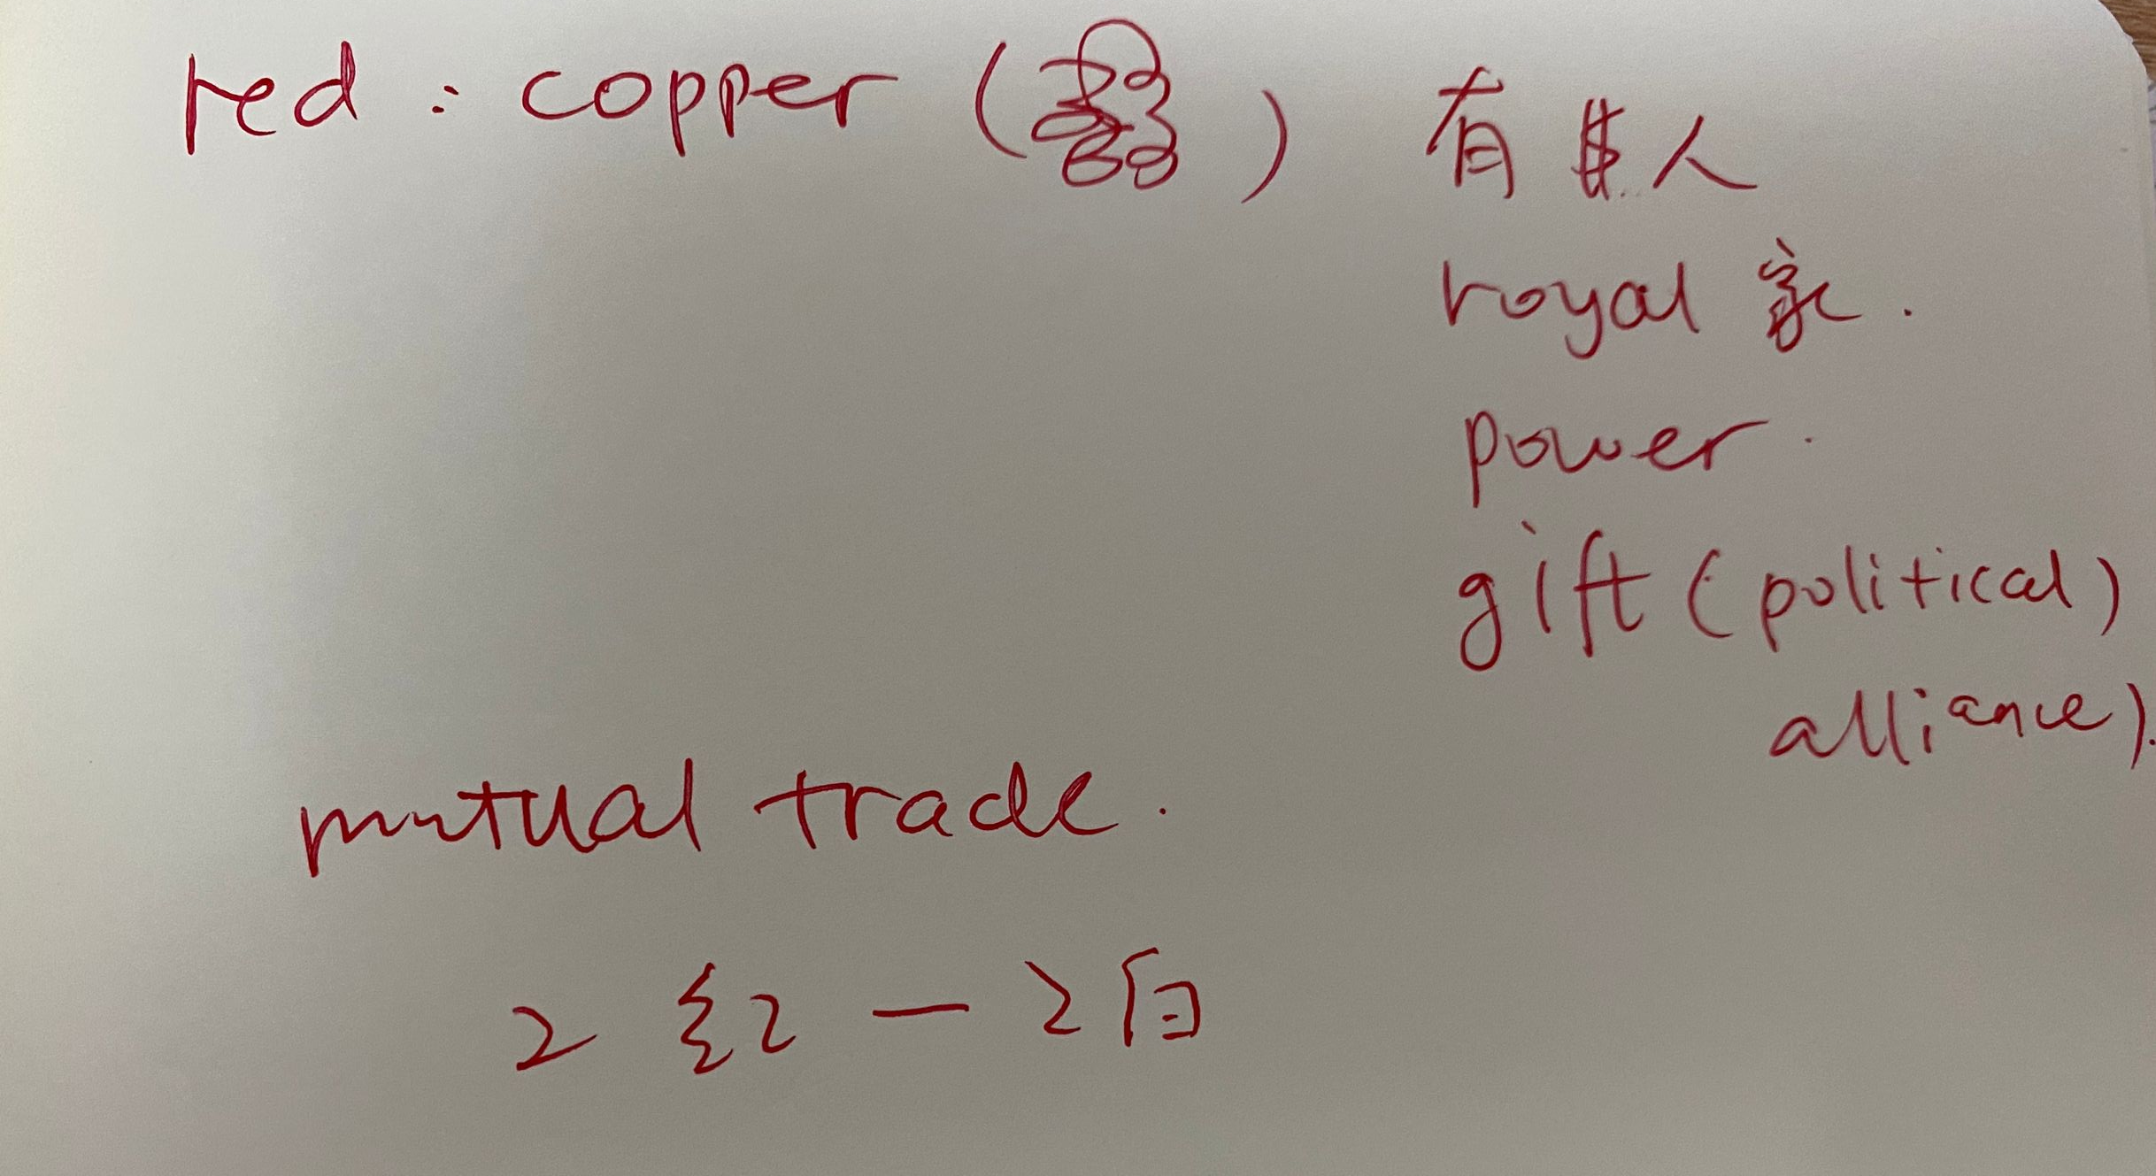
TPO50-lecture1

Slide 43
TPO50-lecture 1
1.What is the lecture mainly about?
A. New information about glass production and use in ancient Egypt
B. Whether Egyptians or Mesopotamians were the first to invent glass
C. Differences between Egyptian glass and other kinds of glass
D. Reasons why ancient Egyptians imported glass from other countries

Slide 44
TPO50-lecture 1
3.The professor describes a process for making glass disks. Summarize the process by putting the steps in the correct order. [Click on a sentence. Then drag it to the space where it belongs. The last one is done for you.]
A.Glass-like material is ground up and dyed blue or red.
B.Powdered material is heated at very high temperatures.
C.Crushed quartz and plant ash are heated at low temperatures.
D.Containers are broken to remove glass disks.

Slide 45
TPO50-lecture 1
5.According to the professor, what are two reasons why ancient Egyptians exported glass? [Click on 2 answers.]
A. To build relationships with foreign leaders
B. To hold cooking oil that was sold in other countries
C. To get bronze tools from other countries
D. To acquire colors of glass not made in Egypt

Slide 46
TPO50-lecture 1
6.Why does the professor say this:
A. To emphasize that glass objects were only made in ancient Egypt
B. To find out what the student does not understand
C. To indicate that there was no contradiction in her previous statement
D. To correct what she said in her previous statement

Slide 47
课后作业：
1. 回顾本次课内容，完成心理学+考古学单词记忆内容
2. 完成TPO10-4；14-1；30-1；
28-4；33-1；37-2的所有lecture题目
3. 预习第五次课中天文学+地质地理词汇
题目群里打卡

Slide 48

【✨课程福利✨】
1. 微博打卡：#考虫托福系统班#+天数+收获+图片+@考虫托福 @相应科目的老师 @酵母菁
（1）每周一抽取2个上周连续打卡的虫子送抱枕
2. 听课评论，听课后点击右上角【评论】按钮，说说虫子们对课程的想法和感受，课程结束后抽2个考虫T恤喔！

Slide 49
综合练习：
TPO10-L4

Slide 50
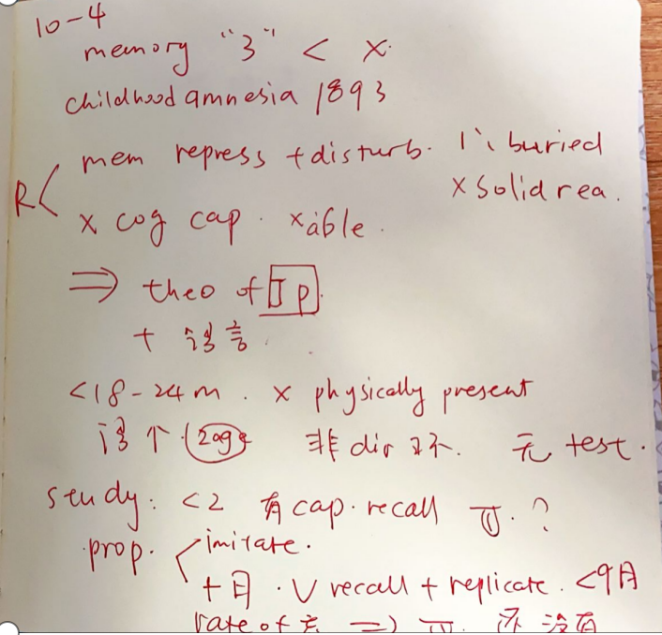
综合练习：
TPO10-L4

Slide 51
End

